Slide 1
A fuzzy optimisation model for decision making in a reverse logistics network design
Presented By:
Jyoti Darbari
Lady Shri Ram College University of Delhi, New Delhi, India

Slide 2
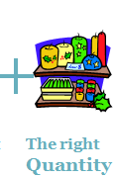
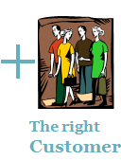
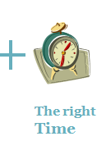
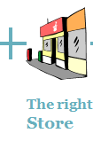
Supply Chain
A Supply Chain consists of a series of activities involving many organizations through which the materials move from initial suppliers to final customers”

Slide 3
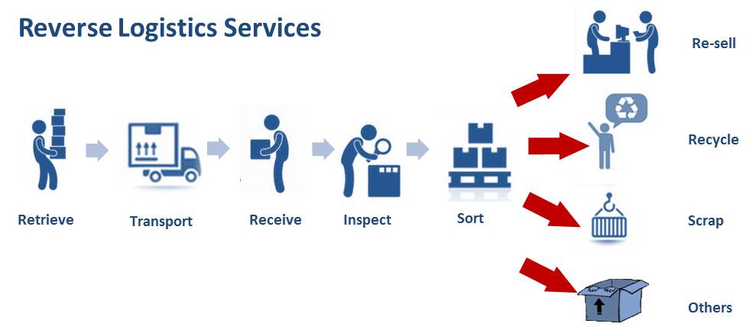
Reverse Supply Chain
A reverse supply chain is a means of enhancing sustainability by retrieving products from customers.
Reverse Logistics
“ Process of planning, implementing, and controlling the efficient, cost effective flow of raw materials, in-process inventory, finished goods and related information from the point of consumption to the point of origin for the purpose of recapturing value or proper disposal”.
- Rogers and Tibben-Lembke

Slide 4
Rl Processes and Recovery Options
Direct Use
CUSTOMERS
Product Reprocessing
Component Retrieval and Reprocessing
Collection
Inspection
Material Recovery
Disposal

Slide 5
Current Study
Location of Collection centers and potential RFCs in NCR
Bawana(RFC5)
Mayapuri Industrial Area(RFC1)
Dwarka(RFC5)
Badarpur(RFC2)
Eco-Tech1(RFC3)

Slide 6
Current Study
In this study, evaluation of alternative locations for a recovery facility centre is done based on a number of economical and socio-environmental criteria to obtain the most suitable one.
In the second stage, for the design of a economically and environmentally effective transportation network for flow of returns from CCs to the selected RFC, the set of CCs are grouped into zones.
Finally, we formulate a Fuzzy Mixed Integer Linear Programming mathematical model or the planning of sustainable reverse logistics network with aim of minimizing the environmental impact (in terms of carbon emission) of the RL model.

Slide 7
Proposed Methodology
Fuzzy -ANP technique is used for evaluation of RFC
Cluster Analysis approach for allocation of CCs to zones
Formulate a mathematical model to determine optimal routes for recovery flow network

Slide 8
The Analytical Network Process(ANP)
The analytic network process (ANP) is a more general form of the analytic hierarchy process (AHP) used in multi-criteria decision analysis.
ANP structures a decision problem into a network with a goal, decision criteria, and alternatives which makes it possible for one to deal systematically with all kinds of dependence and feedback.
The power of the Analytic Network Process (ANP) lies in its use of ratio scales to capture all kinds of interactions and make accurate predictions, and, even further, to make better decisions.

Slide 9
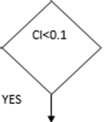
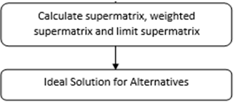
Flow chart of Fuzzy ANP

Slide 10
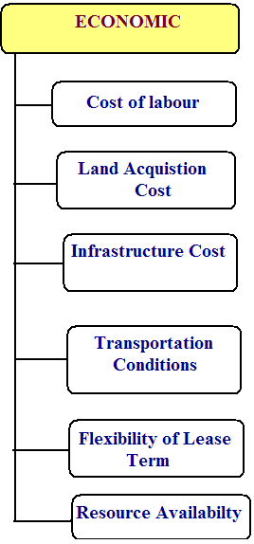
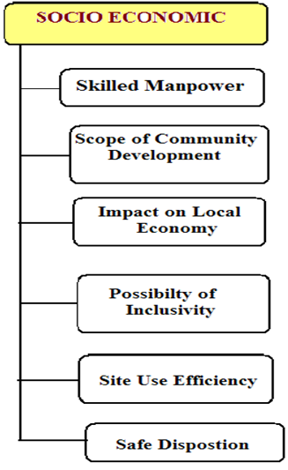
Factors for selection of Recovery Facility Center(RFC)

Slide 11
Triangular Judgement Matrix
TFNs are used to represent the subjective pair wise comparisons
equal importance=1, moderate importance=3,strong importance=5, very strong importance=7 extremely strong importance=9.
A triangular fuzzy number can be characterized as:
with the interval of confidence level .
For example:
And we get the following fuzzy judgement matrix:
Transportation-TC | Eco-Tech-1 | Badarpur | Mayapuri | Dwarka | Bawana
Eco-Tech-1 | 1 | [1,3] | [3,5] | [1,2] | [2,4]
Badarpur | [1/3,1] | 1 | [1,3] | [1,2] | [2,4]
Mayapuri | [1/5,1/3] | [1/3,1] | 1 | [1/5,1/3] | [1/3,1]
Dwarka | [1/2,1] | [1/2,1] | [3,5] | 1 | [1,3]
Bawana | [1/4,1/2] | [1/4,1/2] | [1,3] | [1/3,1] | 1

Slide 12
Defuzzification of judgement matrix and deriving local priority vector
Degree of satisfaction for the judgement matrix is estimated by the index of optimism defined as (Lee 1999):
the local priority vector is calculated using the following equation
where is the largest eigenvalue of A
For consistency of the matrix, the consistency ratio CR is to be less than 0.1 where
The judgement matrix and the priority vector are hence obtained:
Transportation TC | Eco-Tech-1 | Badarpur | Mayapuri | Dwarka | Bawana | Eigenvector(w)
Eco-Tech-1 | 1 | 2 | 4 | 1 | 3 | 0.32
Badarpur | 0.5 | 1 | 2 | 0.5 | 3 | 0.18
Mayapuri | 0.25 | 0.5 | 1 | 0.25 | 0.5 | 0.07
Dwarka | 1 | 2 | 4 | 1 | 2 | 0.30
Bawana | 0.333333 | 0.333333 | 2 | 0.5 | 1 | 0.11

Slide 13
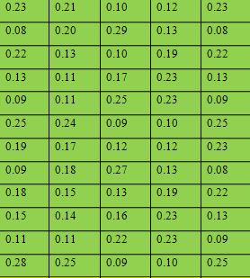
Super-matrix for locations before convergence
 | CL | LCA | IC | TC | FLT | RA | SM | SCD | ILE | PI | SUE | SD | RFC1 | RFC2 | RFC3 | RFC4 | RFC5
CL | 0.00 | 0.00 | 0.00 | 0.00 | 0.00 | 0.16 | 0.00 | 0.00 | 0.00 | 0.00 | 0.00 | 0.00
LCA | 0.00 | 0.00 | 0.00 | 0.00 | 0.67 | 0.28 | 0.00 | 0.00 | 0.00 | 0.00 | 0.00 | 0.00
IC | 0.00 | 0.00 | 0.00 | 1.00 | 0.33 | 0.08 | 0.00 | 0.00 | 0.00 | 0.00 | 0.00 | 0.00
TC | 0.00 | 0.00 | 0.00 | 0.00 | 0.00 | 0.09 | 0.00 | 0.00 | 0.00 | 0.00 | 0.00 | 0.00
FLT | 0.00 | 1.00 | 0.00 | 0.00 | 0.00 | 0.39 | 0.00 | 0.00 | 0.00 | 0.00 | 0.00 | 0.00
RA | 0.00 | 0.00 | 0.00 | 0.00 | 0.00 | 0.00 | 0.00 | 0.00 | 0.00 | 0.00 | 0.00 | 0.00
SM | 0.00 | 0.00 | 0.00 | 0.00 | 0.00 | 0.00 | 0.00 | 0.00 | 0.00 | 0.00 | 0.00 | 0.00
SCD | 0.00 | 0.00 | 0.00 | 0.00 | 0.00 | 0.00 | 0.00 | 0.00 | 1.00 | 0.50 | 0.40 | 0.00
ILE | 0.00 | 0.00 | 0.00 | 0.00 | 0.00 | 0.00 | 0.00 | 0.33 | 0.00 | 0.50 | 0.60 | 0.00
PI | 0.00 | 0.00 | 0.00 | 0.00 | 0.00 | 0.00 | 0.00 | 0.67 | 0.00 | 0.00 | 0.00 | 0.00
SUE | 0.00 | 0.00 | 0.00 | 0.00 | 0.00 | 0.00 | 1.00 | 0.00 | 0.00 | 0.00 | 0.00 | 1.00
SD | 0.00 | 0.00 | 0.00 | 0.00 | 0.00 | 0.00 | 0.00 | 0.00 | 0.00 | 0.00 | 0.00 | 0.00
RFC1 |  |  |  |  |  |  |  |  |  |  |  |  | 0.00 | 0.00 | 0.00 | 0.00 | 0.00
RFC2 |  |  |  |  |  |  |  |  |  |  |  |  | 0.00 | 0.00 | 0.00 | 0.00 | 0.00
RFC3 |  |  |  |  |  |  |  |  |  |  |  |  | 0.00 | 0.00 | 0.00 | 0.00 | 0.00
RFC4 |  |  |  |  |  |  |  |  |  |  |  |  | 0.00 | 0.00 | 0.00 | 0.00 | 0.00
RFC5 |  |  |  |  |  |  |  |  |  |  |  |  | 0.00 | 0.00 | 0.00 | 0.00 | 0.00

Slide 14
Super-matrix for locations after convergence (A⁶⁴)
 | CL | LCA | IC | TC | FLT | RA | SM | SCD | ILE | PI | SUE | SD | RFC1 | RFC2 | RFC3 | RFC4 | RFC5
CL | 0.03 | 0.03 | 0.03 | 0.03 | 0.03 | 0.03 | 0.03 | 0.03 | 0.03 | 0.03 | 0.03 | 0.03 | 0.03 | 0.03 | 0.03 | 0.03 | 0.03
LCA | 0.06 | 0.06 | 0.06 | 0.06 | 0.06 | 0.06 | 0.06 | 0.06 | 0.06 | 0.06 | 0.06 | 0.06 | 0.06 | 0.06 | 0.06 | 0.06 | 0.06
IC | 0.06 | 0.06 | 0.06 | 0.06 | 0.06 | 0.06 | 0.06 | 0.06 | 0.06 | 0.06 | 0.06 | 0.06 | 0.06 | 0.06 | 0.06 | 0.06 | 0.06
TC | 0.03 | 0.03 | 0.03 | 0.03 | 0.03 | 0.03 | 0.03 | 0.03 | 0.03 | 0.03 | 0.03 | 0.03 | 0.03 | 0.03 | 0.03 | 0.03 | 0.03
FLT | 0.06 | 0.06 | 0.06 | 0.06 | 0.06 | 0.06 | 0.06 | 0.06 | 0.06 | 0.06 | 0.06 | 0.06 | 0.06 | 0.06 | 0.06 | 0.06 | 0.06
RA | 0.03 | 0.03 | 0.03 | 0.03 | 0.03 | 0.03 | 0.03 | 0.03 | 0.03 | 0.03 | 0.03 | 0.03 | 0.03 | 0.03 | 0.03 | 0.03 | 0.03
SM | 0.03 | 0.03 | 0.03 | 0.03 | 0.03 | 0.03 | 0.03 | 0.03 | 0.03 | 0.03 | 0.03 | 0.03 | 0.03 | 0.03 | 0.03 | 0.03 | 0.03
SCD | 0.10 | 0.10 | 0.10 | 0.10 | 0.10 | 0.10 | 0.10 | 0.10 | 0.10 | 0.10 | 0.10 | 0.10 | 0.10 | 0.10 | 0.10 | 0.10 | 0.10
ILE | 0.08 | 0.08 | 0.08 | 0.08 | 0.08 | 0.08 | 0.08 | 0.08 | 0.08 | 0.08 | 0.08 | 0.08 | 0.08 | 0.08 | 0.08 | 0.08 | 0.08
PI | 0.06 | 0.06 | 0.06 | 0.06 | 0.06 | 0.06 | 0.06 | 0.06 | 0.06 | 0.06 | 0.06 | 0.06 | 0.06 | 0.06 | 0.06 | 0.06 | 0.06
SUE | 0.06 | 0.06 | 0.06 | 0.06 | 0.06 | 0.06 | 0.06 | 0.06 | 0.06 | 0.06 | 0.06 | 0.06 | 0.06 | 0.06 | 0.06 | 0.06 | 0.06
SD | 0.03 | 0.03 | 0.03 | 0.03 | 0.03 | 0.03 | 0.03 | 0.03 | 0.03 | 0.03 | 0.03 | 0.03 | 0.03 | 0.03 | 0.03 | 0.03 | 0.03
RFC1 | 0.07 | 0.07 | 0.07 | 0.07 | 0.07 | 0.07 | 0.07 | 0.07 | 0.07 | 0.07 | 0.07 | 0.07 | 0.07 | 0.07 | 0.07 | 0.07 | 0.07
RFC2 | 0.06 | 0.06 | 0.06 | 0.06 | 0.06 | 0.06 | 0.06 | 0.06 | 0.06 | 0.06 | 0.06 | 0.06 | 0.06 | 0.06 | 0.06 | 0.06 | 0.06
RFC3 | 0.10 | 0.10 | 0.10 | 0.10 | 0.10 | 0.10 | 0.10 | 0.10 | 0.10 | 0.10 | 0.10 | 0.10 | 0.10 | 0.10 | 0.10 | 0.10 | 0.10
RFC4 | 0.06 | 0.06 | 0.06 | 0.06 | 0.06 | 0.06 | 0.06 | 0.06 | 0.06 | 0.06 | 0.06 | 0.06 | 0.06 | 0.06 | 0.06 | 0.06 | 0.06
RFC5 | 0.06 | 0.06 | 0.06 | 0.06 | 0.06 | 0.06 | 0.06 | 0.06 | 0.06 | 0.06 | 0.06 | 0.06 | 0.06 | 0.06 | 0.06 | 0.06 | 0.06

Slide 15
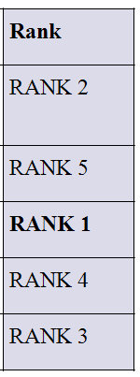
Ideal value for locations based on economic factors
Potential location | Normalised weights | Rank
Eco-Tech-1(RFC1) | 0.699615
Badarpur (RFC2) | 0.600138
Mayapuri Industrial Area (RFC3) | 1
Dwarka (RFC4) | 0.609388
Bawana (RFC5) | 0.632196

Slide 16
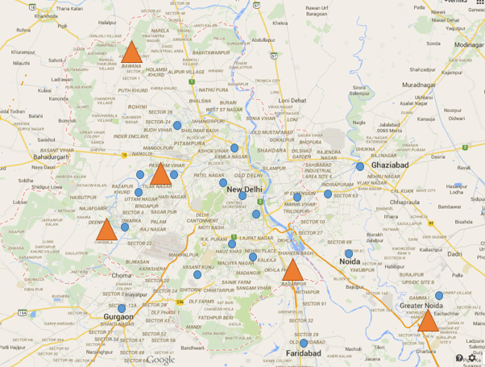
Location of Collection centres and selected RFC in NCR
Maya Puri (RFC3)

Slide 17
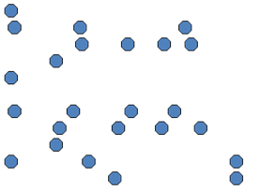
Objectives of Cluster Analysis
Finding groups of objects such that the objects in a group will be similar (or related) to one another and different from (or unrelated to) the objects in other groups
Thus, Clustering of data is a method by which large sets of data is grouped into clusters of smaller sets of similar data
Competing objectives
Inter-cluster distances are maximized
Intra-cluster distances are minimized

Slide 18
Ward’s method
Similarity of two clusters is based on the increase in squared error when two clusters are merged
At each step, Ward's method calculates the within-cluster sum of squares (WCSS) for every cluster.
WCSS is the squared Euclidean distance between an object in the cluster and the mean of that cluster , summed over all(m) objects in that cluster and is given by the following Equation:

Slide 19
Dendogram
Dendogram is a tree like diagram that records the sequence of merges or splits
Dendogram shows how the clusters are merged heirarchically by decomposing data objects into a several levels of nested partitioning .
A clustering of the data objects is obtained by cutting the dendrogram at the desired level, then each connected component forms a cluster.

Slide 20
Construction of Collection Zones using Ward’s Method

Slide 21
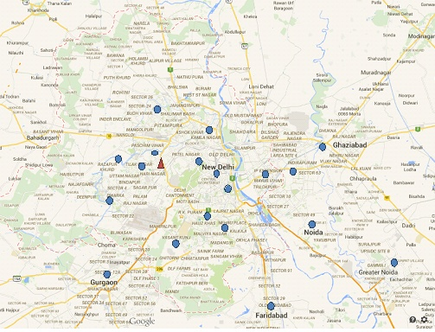
Location of Collection centers and RFC in NCR
Rohini
Model Town
Punjabi B
Karol Bagh
Janak Puri
Rajouri G
Maya Puri
CP
Mayur Vihar
Vaishali
Mathura road
Dwarka
South Ex
East of Kailash
Vasant Kunj
Sushant Lok

Slide 22
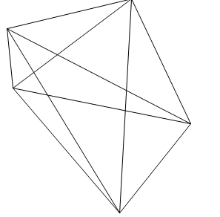
Vehicle Routing Problem
Nodes: physical locations
Recovery Facility Centre
Collection Centres.
Arcs or Links
Transportation links
Number on each arc represents
cost, distance,or travel time.
Routes:{1,2,3,4,5} and {a,b,c,d}
8
7
4
6
9
3
RFC
10
5
1
2

Slide 23
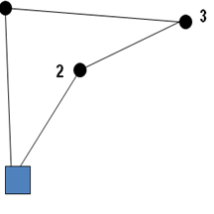
VRP-Optimal Solution
No subtouring is allowed
Route is as short as possible.
Every customer (node) is visited once, including the depot.
Each node has one arc in and one arc out.
1
3
1
2
4
5
depot
6

Slide 24
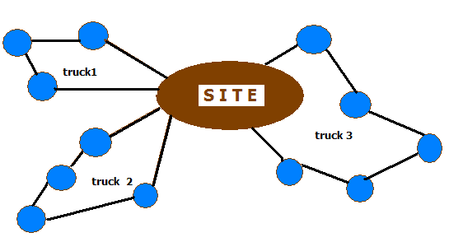
Vehicle Routing Problem-Current Study
Vehicle Routing Problem (VRP) integrates the decisions of determining:
An optimal selection of vehicles for collection of returns from collection centres
An optimal assignment of routes to vehicles
Best route chosen to
minimum distance

Slide 25
Optimization model
Sets
L set of collection centers (CC) index by l, l=1, 2.., L
V set of vehicles index by v
Parameters
number of products returned at l^{th} CC
set of collection centres in the r^{th} cluster zone
r^{th} cluster zone , where ‘0’ represents the
Recovery Facility centre (RFC)
per unit emission of CO₂e per unit km by the v^{th} truck
capacity (in terms of number of units of products) of v^{th} truck
distance between the p^{th} and q^{th} CCs of the r^{th} cluster zone
maximum allowable distance per each route

Slide 26
Decision Variables
real numbers used to avoid subtouring in the routes within each cluster

Slide 27
Objective functions:
Objective Function
The objective minimises the environmental impact of the transportation network of the Reverse Flow.

Slide 28
Constraints
The total number of units collected by v^{th} vehicle within each cluster zone must be less than its capacity and distance of travel must not exceed the maximum allowable limit
Each CC must be visited by exactly one truck

Slide 29
Constraints
From each CC, exactly one vehicle exits
The vehicle that visits a CC must also exit from the CC
The total number of vehicles selected for collection does not exceed the availability

Slide 30
Constraints
A selected vehicle must start from and end at the RFC
Only the selected vehicle must visit the RFC
No subtouring is allowed by any vehicle
The non-negativity restrictions

Slide 31
Result and Discussion

Slide 32
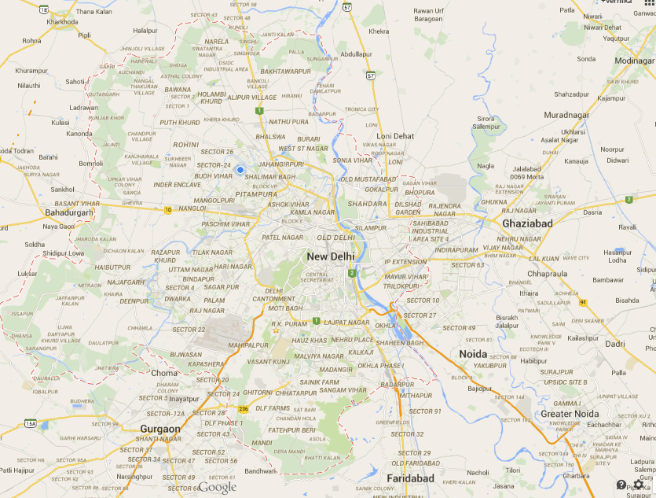
Routes within cluster 1
Rohini
Model Town
Punjabi B
Janak Puri
Maya Puri
Rajouri G
Karol Bagh
Dwarka

Slide 33
Routes within cluster 2
Maya Puri
CP
Mathura road
South Ex
East of Kailash
Vasant Kunj
Sushant Lok

Slide 34
Routes within cluster 3
Maya Puri
Mayur Vihar
Vaishali

Slide 35
Routes within clusters

Slide 36
Conclusion
The main contribution of the paper lies in the development of a decision support tool for DMs for planning a sustainable RL model for an Electronics manufacturing company which includes locating a new RFC and determining the collection routes with optimal selection of vehicles.
The recovery model proposed in the study allows for the selection of the best location for a recovery facility centre taking into account sustainable criteria and an optimization model for designing an efficient routing network.
The opinions of the DMs are subjective and thus there is a possibility of ambiguity in the final decisions. In order to tackle this, fuzzy ANP is implemented.
For future work, fuzzy ANP can be combined with other multi criteria approaches in order to reduce the possibility of biasness in the subjective inputs.

Slide 37
References
Anderberg, M. R. (1973). Cluster analysis for applications (No. OAS-TR-73-9). OFFICE OF THE ASSISTANT FOR STUDY SUPPORT KIRTLAND AFB N MEX.
Barreto, S., Ferreira, C., Paixao, J., & Santos, B. S. (2007). Using clustering analysis in a capacitated location-routing problem. European Journal of Operational Research, 179(3), 968-977.
Chang, N. B., Parvathinathan, G., & Breeden, J. B. (2008). Combining GIS with fuzzy multicriteria decision-making for landfill siting in a fast-growing urban region. Journal of environmental management, 87(1), 139-153.
Choudhary, D., & Shankar, R. (2012). An STEEP-fuzzy AHP-TOPSIS framework for evaluation and selection of thermal power plant location: A case study from India. Energy, 42(1), 510-521.
Guneri, A. F., Cengiz, M., & Seker, S. (2009). A fuzzy ANP approach to shipyard location selection. Expert Systems with Applications, 36(4), 7992-7999.
Jain, A. K., & Dubes, R. C. (1988). Algorithms for clustering data. Prentice-Hall, Inc..
Kannan, G., Haq, A. N., & Sasikumar, P. (2008). An application of the analytical hierarchy process and fuzzy analytical hierarchy process in the selection of collecting centre location for the reverse logistics multicriteria decision-making supply chain model. International Journal of Management and Decision Making, 9(4), 350-365.
Liang, Tien-Fu. "Fuzzy multi-objective production/distribution planning decisions with multi-product and multi-time period in a supply chain." Computers & Industrial Engineering 55, no. 3 (2008): 676-694.
Min, H. (1989). The multiple vehicle routing problem with simultaneous delivery and pick-up points. Transportation Research Part A: General, 23(5), 377-386.

Slide 38
References
Önüt, S., & Soner, S. (2008). Transshipment site selection using the AHP and TOPSIS approaches under fuzzy environment. Waste Management, 28(9), 1552-1559.
Özdağoğlu, A. (2012). A multi-criteria decision-making methodology on the selection of facility location: fuzzy ANP. The International Journal of Advanced Manufacturing Technology, 59(5-8), 787-803.
Saaty, T. L. (2000). Fundamentals of decision making and priority theory with the analytic hierarchy process (Vol. 6). Rws Publications.
Tuzkaya, G., & Gülsün, B. (2008). Evaluating centralized return centers in a reverse logistics network: An integrated fuzzy multi-criteria decision approach.International Journal of Environmental Science & Technology, 5, 339-352.
Wadhwa, S., Madaan, J., & Chan, F. T. S. (2009). Flexible decision modeling of reverse logistics system: A value adding MCDM approach for alternative selection. Robotics and Computer-Integrated Manufacturing, 25(2), 460-469.
Ward Jr, J. H. (1963). Hierarchical grouping to optimize an objective function.Journal of the American statistical association, 58(301), 236-244.
Wu, C. R., Lin, C. T., & Chen, H. C. (2009). Integrated environmental assessment of the location selection with fuzzy analytical network process.Quality and Quantity, 43(3), 351-380.
Yang, C. L., Chuang, S. P., Huang, R. H., & Tai, C. C. (2008, December). Location selection based on AHP/ANP approach. In Industrial Engineering and Engineering Management, 2008. IEEM 2008. IEEE International Conference on(pp. 1148-1153). IEEE.
Zimmermann, H-J. "Fuzzy programming and linear programming with several objective functions." Fuzzy sets and systems 1, no. 1 (1978): 45-55.

Slide 39
THANK YOU

