Slide 1
Robe's Restricted Problem of 2+2 Bodies
Department of Mathematics
University of Delhi
Bhavneet Kaur
Lady Shri Ram College For Women
University of Delhi

Slide 2
Three-Body Problem
Suppose m₁, m₂, m₃ are three masses moving under their gravitational attraction, then the study of motion of these bodies under their mutual gravitational force is called the three-body problem.

Slide 3
Restricted Three-Body Problem
y
m₃
F₂
F₁
r
x
O
m₁
m₂

Slide 4
Robe’s Restricted Three-Body Problem
m₃
η
R₃₂
R₁₃
R
M₁
ξ
m₂
O
(Origin)
m₁

Slide 5
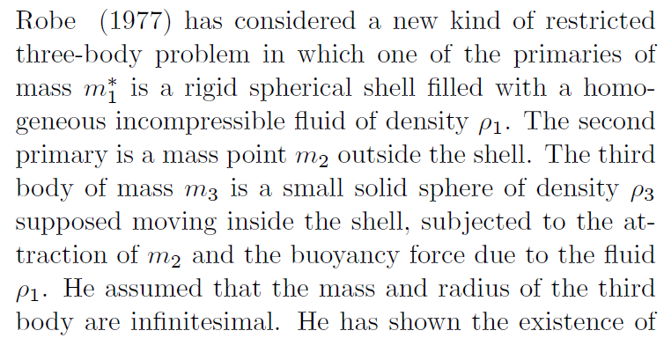
Motivation

Slide 6
Motivation

Slide 7
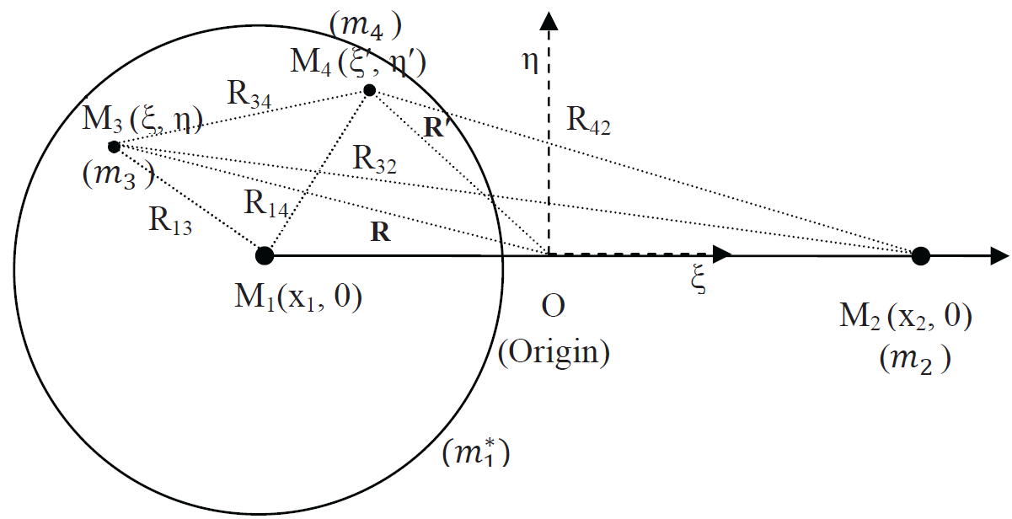
Robe's Restricted Problem of 2+2 Bodies

Slide 8
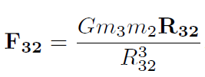
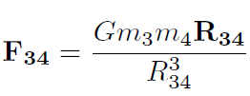
Various forces acting on m₃
Attraction of m₂
Attraction of m₄
Gravitational force exerted by fluid of density ρ₁ on m₃
Buoyancy force

Slide 9
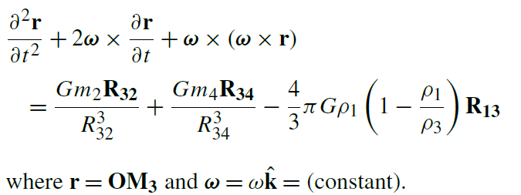
Equations of Motion of m₃
The equation of motion of m₃ in the inertial system
The equation of motion of m₃ in the synodic system

Slide 10
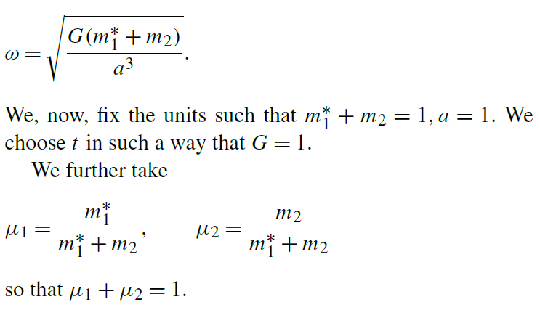
Equations of Motion of m₃
We have

Slide 11
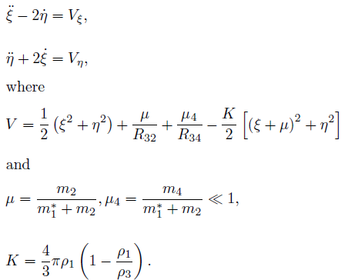
Equations of Motion of m₃

Slide 12
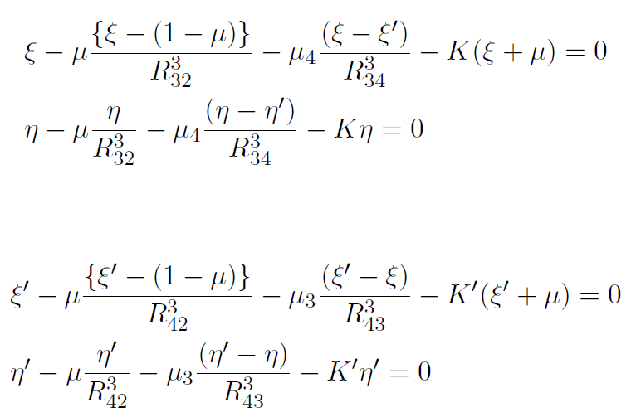
Equilibrium Solutions
The equilibrium solutions of m₃ & m₄ are given by
V_{ξ} =0= V_{η}; V_{ξ'}' =0= V_{η'}‘

Slide 13
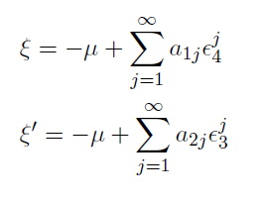
Equilibrium Solutions
Collinear Equilibrium Solutions

Slide 14
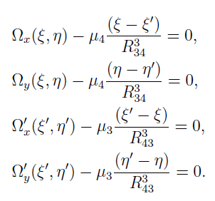
Equilibrium Solutions
The equations of equilibrium solutions can be written as

Slide 15
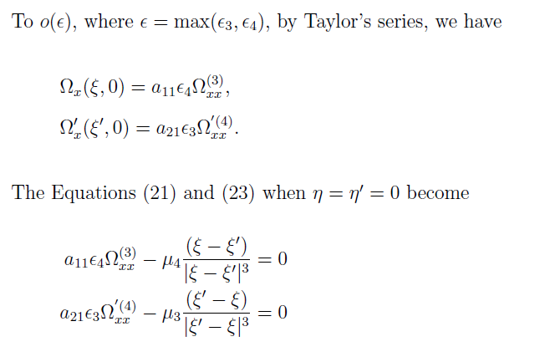
Equilibrium Solutions

Slide 16
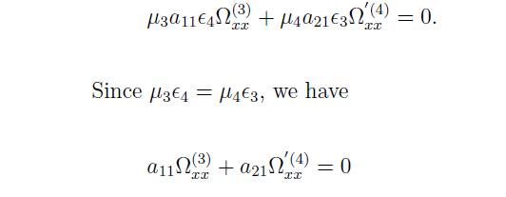
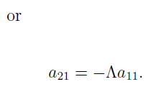
Equilibrium Solutions
The above equations can be combined as

Slide 17
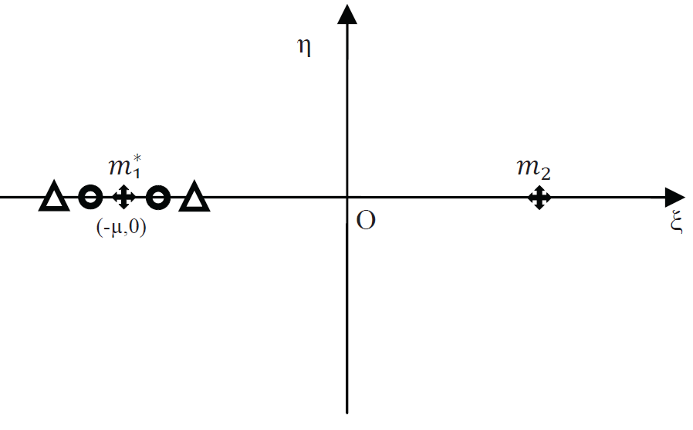
Equilibrium Solutions
±
Location of Collinear Equilibrium Solutions of the Robe's restricted problem of 2+2 bodies. Circles denote the positions of m₃ and triangles denote the positions of m₄

Slide 18
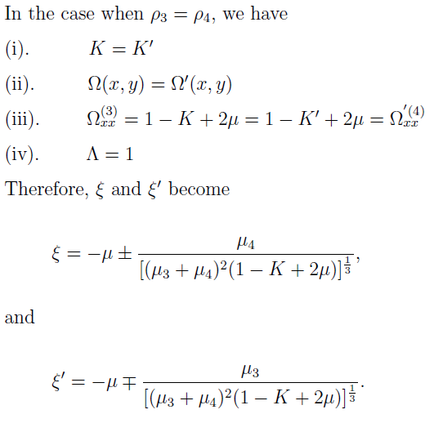
Equilibrium Solutions

Slide 19
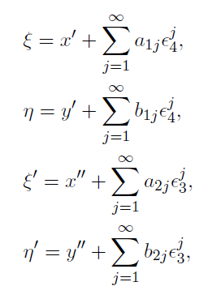
Equilibrium Solutions
Non-Collinear Equilibrium Solutions

Slide 20
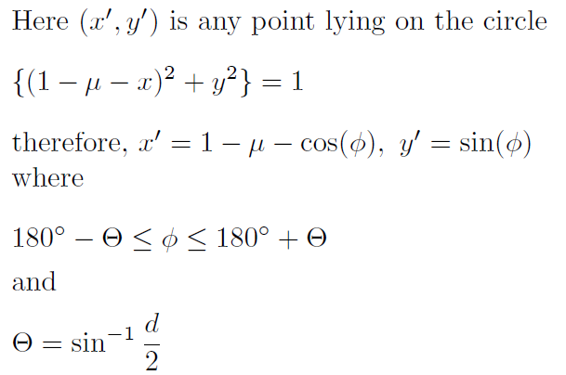
Equilibrium Solutions

Slide 21
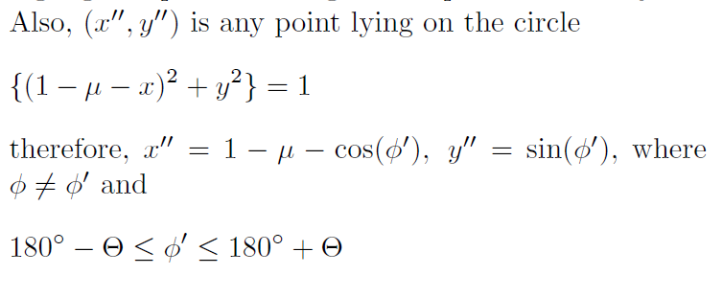
Equilibrium Solutions

Slide 22
Equilibrium Solutions
(
η
d
1
φ
θ
1
ξ
O
(m₂)
Determination of the range of φ to evaluate the equilibrium solutions of m₃ (and similarly m₄)

Slide 23
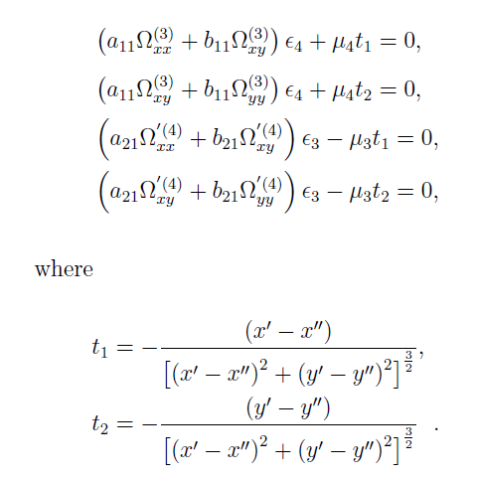
Equilibrium Solutions

Slide 24
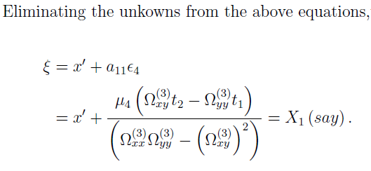
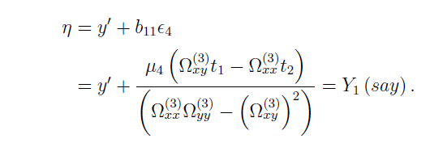
Equilibrium Solutions

Slide 25
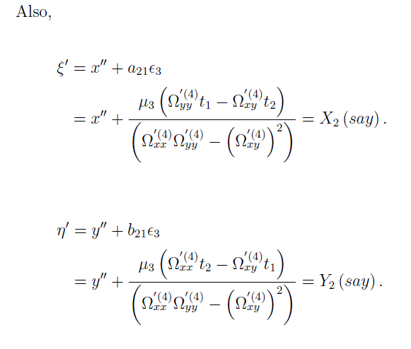
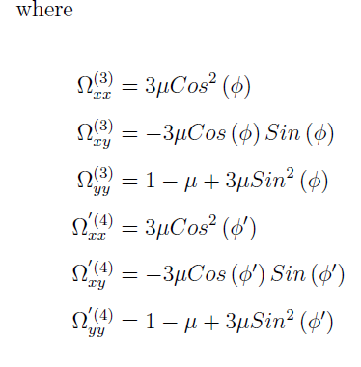
Equilibrium Solutions

Slide 26
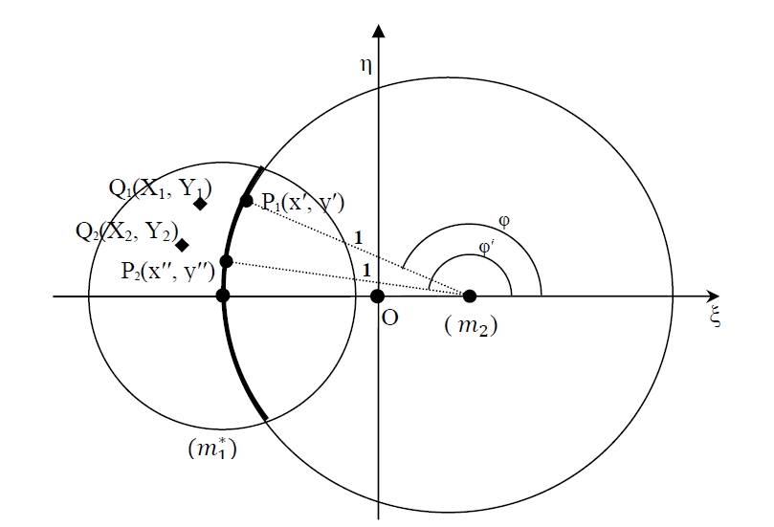
Equilibrium Solutions
Location of Non Collinear equilibrium solutions (when they exist) in the Robe's restricted problem of 2 + 2 bodies

Slide 27
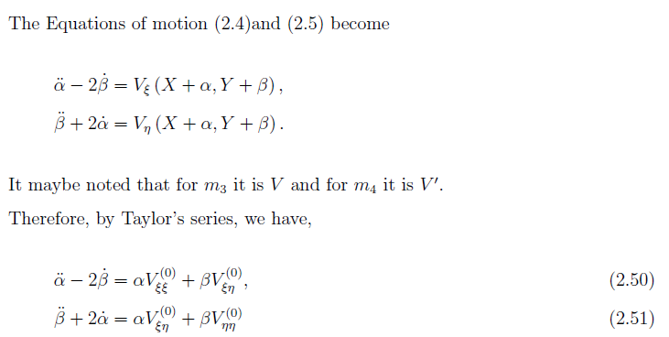
Stability of Equilibrium Solutions

Slide 28
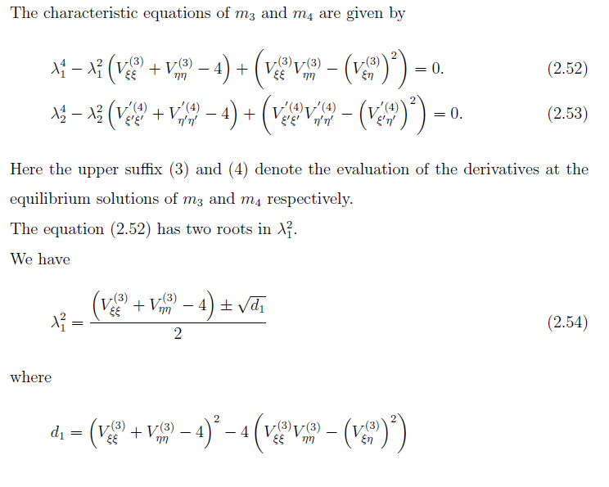
Stability of Equilibrium Solutions
If any of the roots of the characteristic equations is positive and real, the corresponding equilibrium solution will be unstable.

Slide 29
Stability of Equilibrium Solutions
Stability of Collinear Equilibrium Solutions
where

Slide 30
Stability of Equilibrium Solutions

Slide 31
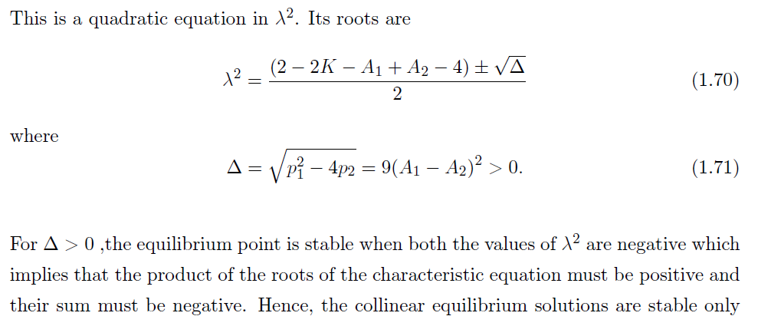
Stability of Equilibrium Solutions

Slide 32
Stability of Equilibrium Solutions
Stability of Non Collinear Equilibrium Solutions

Slide 33
Stability of Equilibrium Solutions

Slide 34
Applications
We consider the two primaries Earth (m₁*) and Moon (m₂) and the infinitesimal masses, two submarines m₃ and m₄.

Slide 35
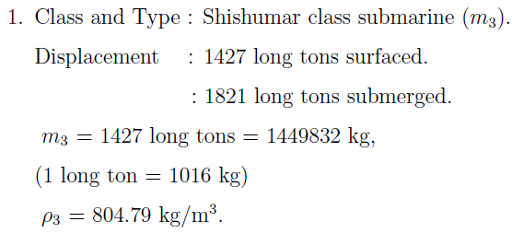
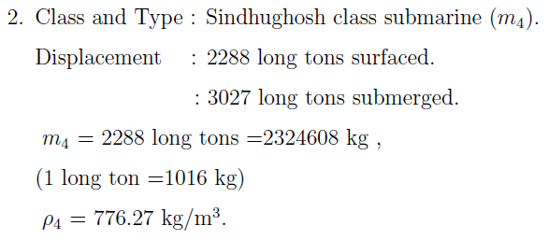
Applications

Slide 36
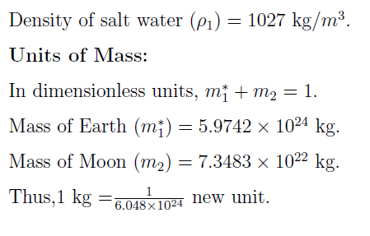
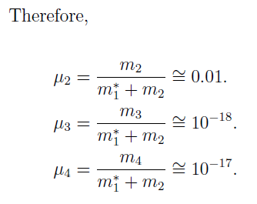
Applications

Slide 37
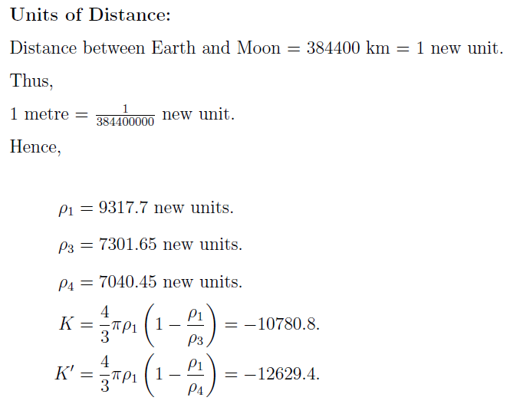
Applications

Slide 38
Applications
We observe that K≠1 -µ and K ′ ≠1 -µ . Hence, there are no non collinear equilibrium solutions of the system in this particular case.
We observe that the collinear equilibrium solutions m₃ and m₄ in this case are unstable.

Slide 39
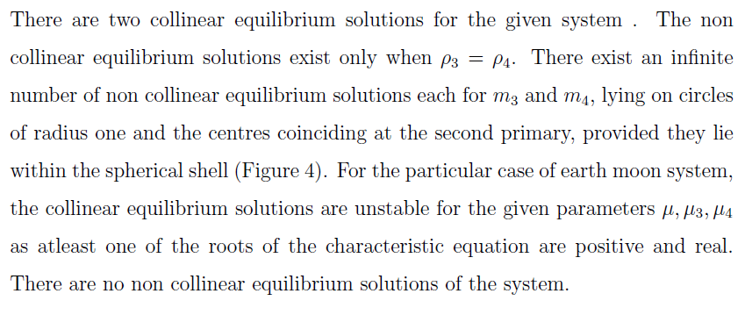
Conclusion

Slide 40
Further Scope of the Problem

Slide 41
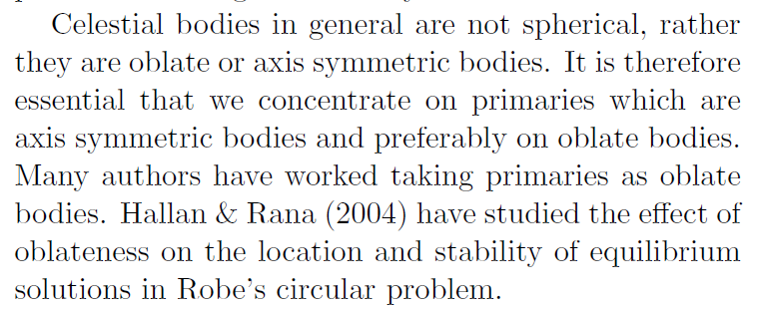

Slide 42
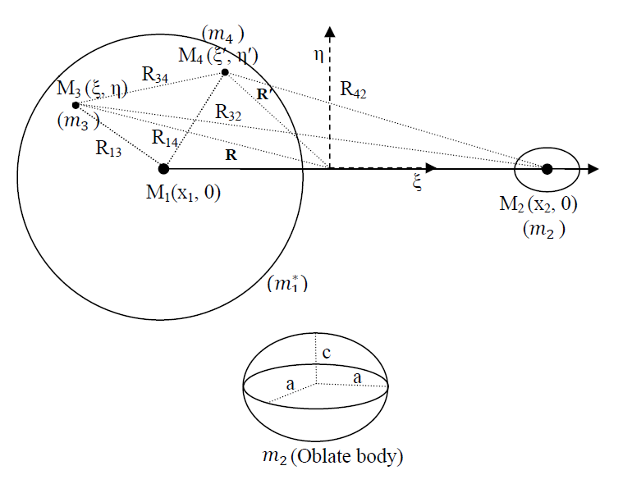
Robe's Restricted Problem of 2+2 Bodies with One of the Primaries an Oblate Body

Slide 43
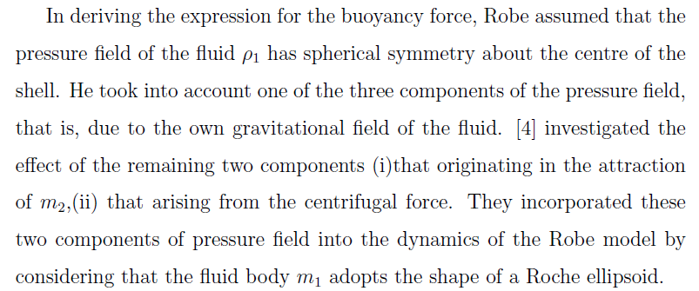
Plastino in their paper “Robe’s Restricted three-body problem revisited” studied the

Slide 44
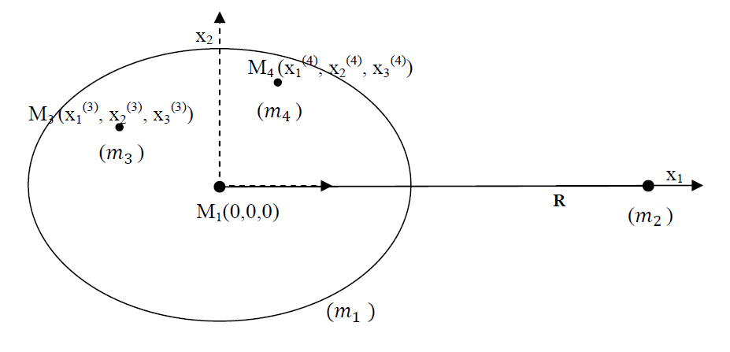
Robe's Restricted Problem of 2+2 Bodies when the Bigger Primary is a Roche Ellipsoid
Geometry of the Robe's restricted problem of 2 + 2 bodies when the bigger primary m₁ is considered as Roche Ellipsoid

Slide 45
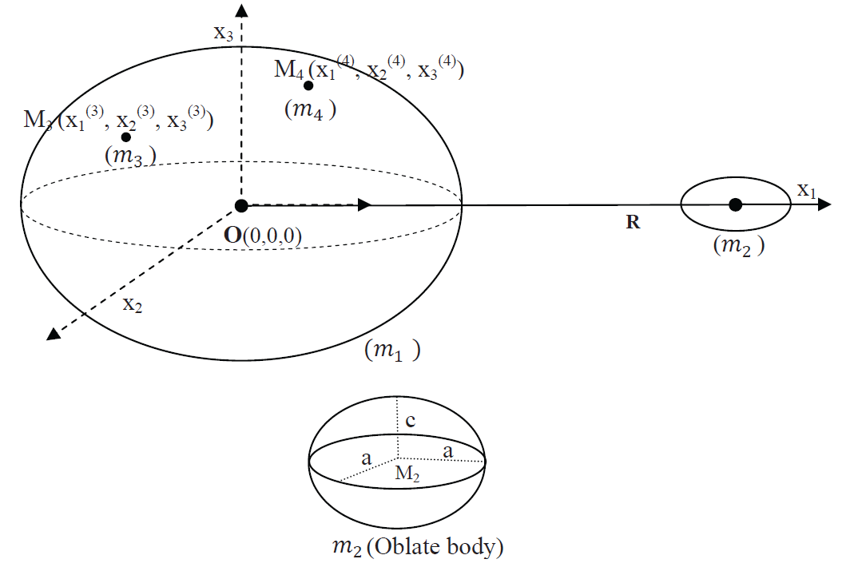
Robe's Restricted Problem of 2+2 Bodies when the Bigger Primary is a Roche Ellipsoid and the Smaller Primary is an Oblate Body

Slide 46
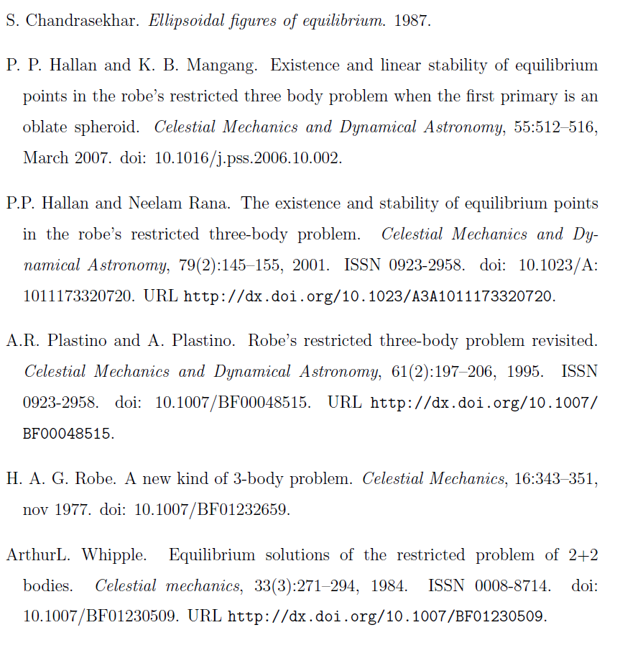
References

Slide 47
References

Slide 48
THANK YOU
Bhavneet Kaur
bhavneet.lsr(at)gmail.com
Lady Shri Ram College For Women
Delhi University

