Slide 1
Uniform Microwave Heating of Thin Ceramic Slabs
Shuchi Agrawal,
Maharaja Agrasen College,
University of Delhi
INDIAN WOMEN and MATHEMATICS,2015
UNIVERSITY of DELHI

Slide 2
Ceramics
What is a ceramic?
Derives from the Greek word ’keramos’ meaning burnt stuff.
Any inorganic or non-metallic material rendered hard and heat resistant by heating at temperatures > 1000 F.
A material suitable for heat processing and characterized by a low thermal conductivity

Slide 3
OUTLINE
Geometry and Formulation of the Physical Problem
One Functional Problem (Real, Physical Case)
- Stationary Solutions (N=1,2,3,4, Source : )
- Stability
Reduced Mathematical Model (Non Physical Case)
- Stationary Solutions (N=1, Source: 1 Delta Function)
- Stationary Solutions (N=2, Source: 2 Delta Functions)

Slide 4
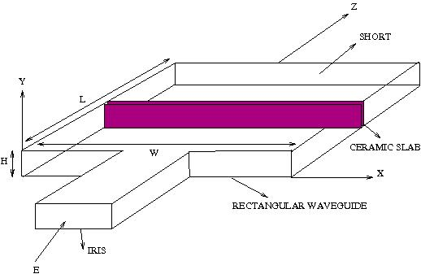
Geometry
Notes:
An electric current depending on a sine wave is passed thru a microwave cavity. Such a current can generate an em field. (an ac current i.e., changing current can produce an em field, most usual form of ac current is a sinusoidal wave. Other forms are a triangular wave or a square wave). The em wave enters the materia, deposits energy and heats up the material. The equation that describes the process takes the form of a reaction diffusion equation. Heat equation with a loss term and a non linear term that depends on the electric field source. We look for steady state solutions, i.e., solutions that do not change with time. Since we are dealing with a highly non linear equation because of the presence of exponential terms, it is not possible to find all the steady states. We look for some that are relatively easier to find, i.e., solutions that do not depend on y. The leading order term in the biot number asymptotic expansion is independent of z, so the solutions only depend on time. By solutions here we mean the temperature along the slab. After these simplifications, the equation becomes a non linear ODE with boundary data/ conditions, which we call a BVP. There are many parameters in the equation. Some are fixed, some are unknown. The BVP is solved by the shooting method where we fix one parameter and target to find another, as in the projectile motion.

Slide 5
Maxwell’s Equations
Notes:
k=Ww/c_0, W is waveguide width, w is source frequency, c_0 is speed of light in free space, I^2=e/e_0 (index of refraction and is equal to 1), e_0 permittivity of free space, e is effective permittivity of ceramic inside the cylinder

Slide 6
Dimensionless Heat Equation
Notes:
Describes the thermal behaviour of the slab.

Slide 7
Thermal modeling
Notes:
When the previous form of E is put in the heat eqn, we get the above form of heat eqn. |e|^2 is the total electric field. Expand U in the Biot number limit and equate terms with equal powers of B. First eqn gives that U0 is a fn of x, y and t only. Second eqn gives a sol. Cond.

Slide 8
A functional reaction-diffusion equation (One Functional Problem)
Notes:
Norm of the electric field is proportional to sin term and TN(u) term is proportional to the functional term.

Slide 9
Stationary solutions u₀ (y independent)
(1)
Symmetric solution : Control parameter is L₂ norm of u₀
Asymmetric solution : Control parameter is u₀(0)
Notes:
Eqn admits 2 stat. solns.

Slide 10
Symmetric stationary solution
Related initial value problem
(2)
Solution of (2) satisfies (1) if
(3)
Notes:
Adding the norm constraint leads us to the symmetric solution.

Slide 11
Define
(*)

Slide 12
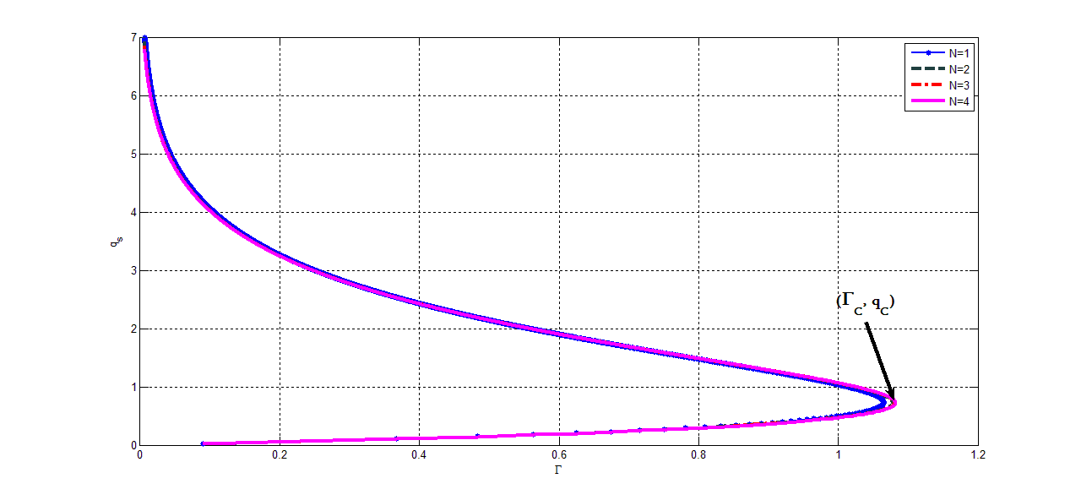
(*) gives maximum temperature along surface of slab as a function of power.
Maximum temperature is a multi-valued function of
2 solutions for
No solution for

Slide 13
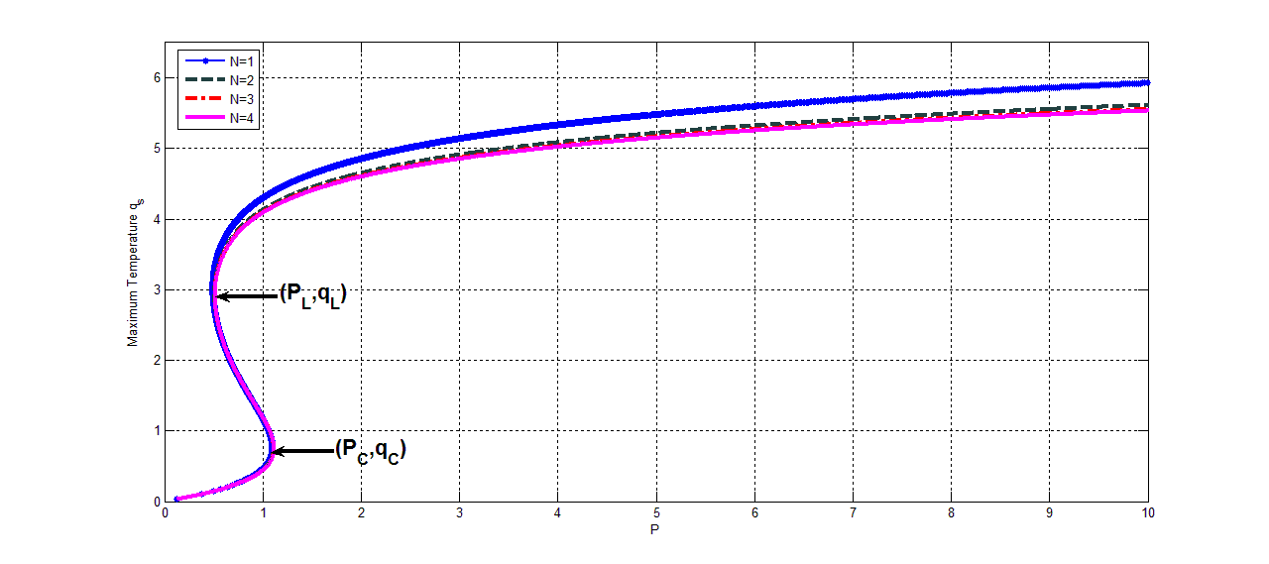
Three stationary solutions for P_{L}<P<P_{C} and one for P<P_{L} and P>P_{C}
For same value of power, maximum temperature decreases as N increases

Slide 14
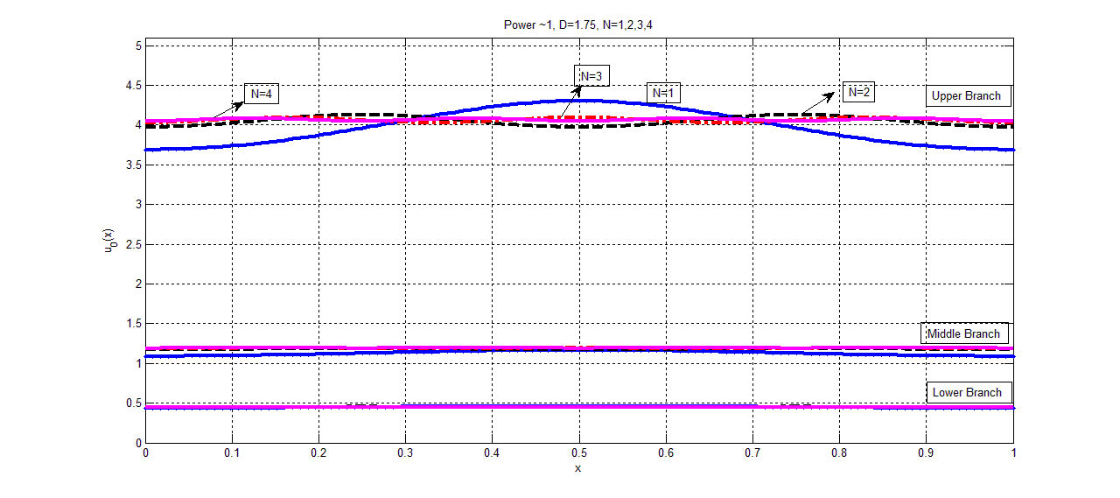

Slide 15
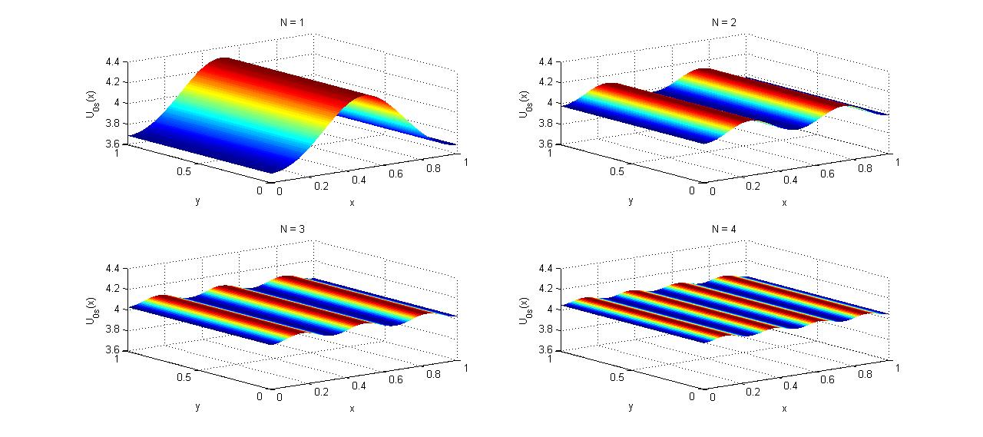

Slide 16
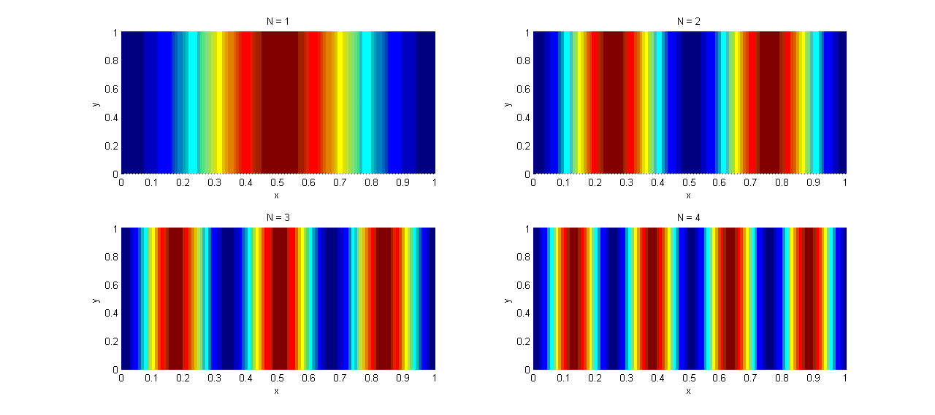
Maximum temperature is at points of maximum of the source term.

Slide 17
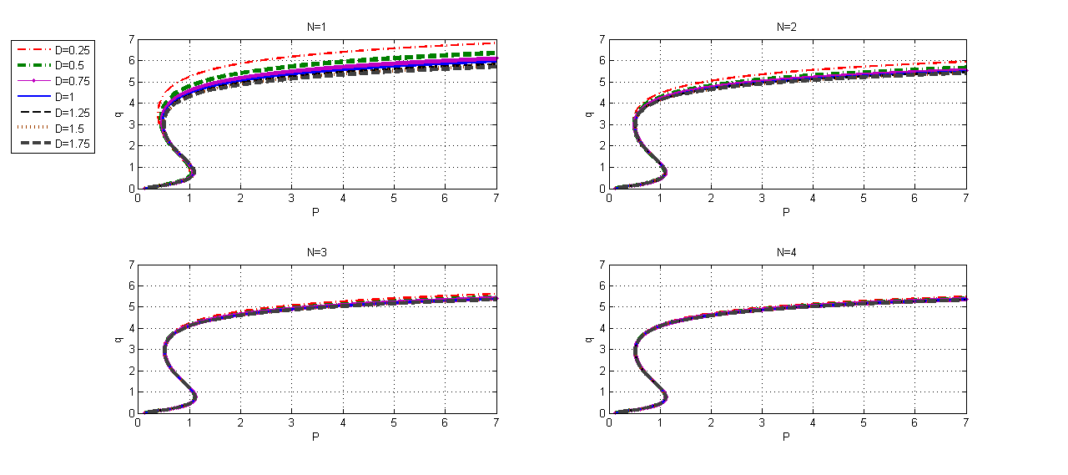
Max temperature as a function of power for several values of D and N
For the same value of power, maximum temperature is more for a smaller value of D. This holds for all values of N.
For a larger value of N, the change in maximum temperature is less with the decrease of D. This means temperature becomes more uniform as N increases.

Slide 18
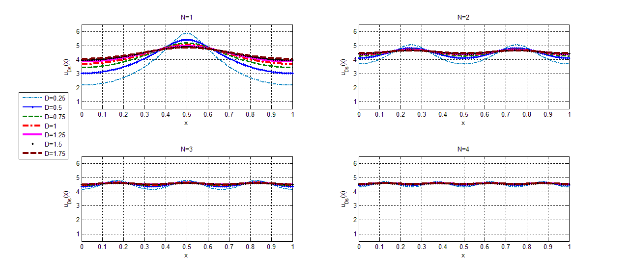
Symmetric stationary temperature as a function of x when P=2
Maximum temperature increases and solutions become more localized as D decreases. This shows that uniformity in solutions increases with D

Slide 19
Asymmetric stationary solution
Again consider the initial value problem
Solution of above problem satisfies (1) if
(2)
(4)
Define

Slide 20
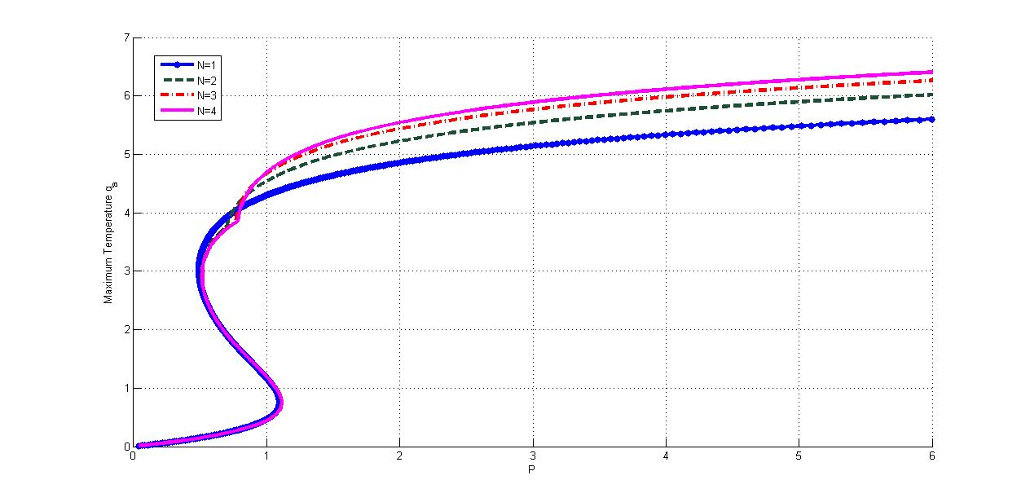
Max temperature along the surface of the slab as a function of power.
On the asymmetric branch, for the same value of power, maximum temperature increases with N (contrary to the symmetric case)

Slide 21
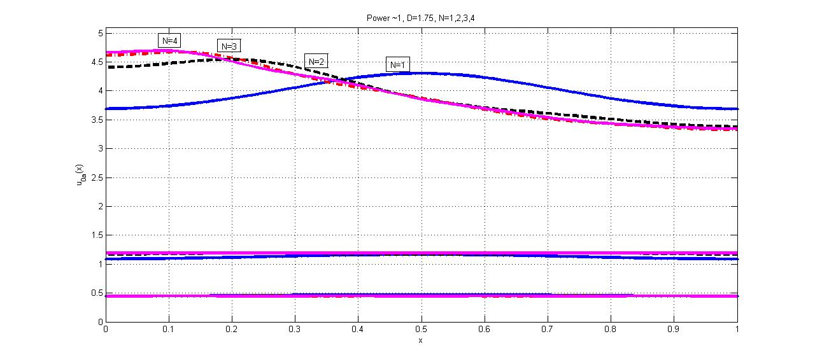
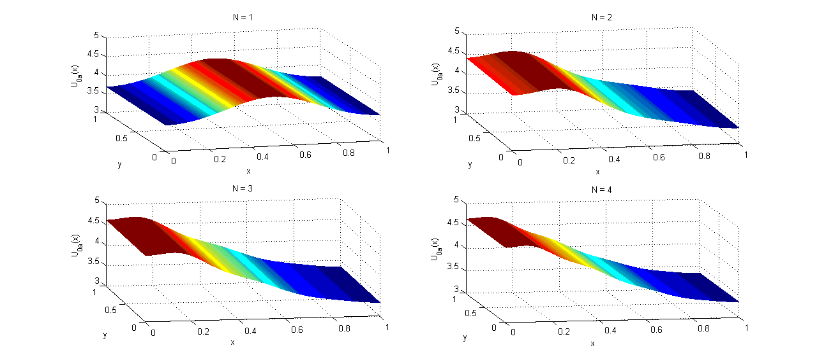
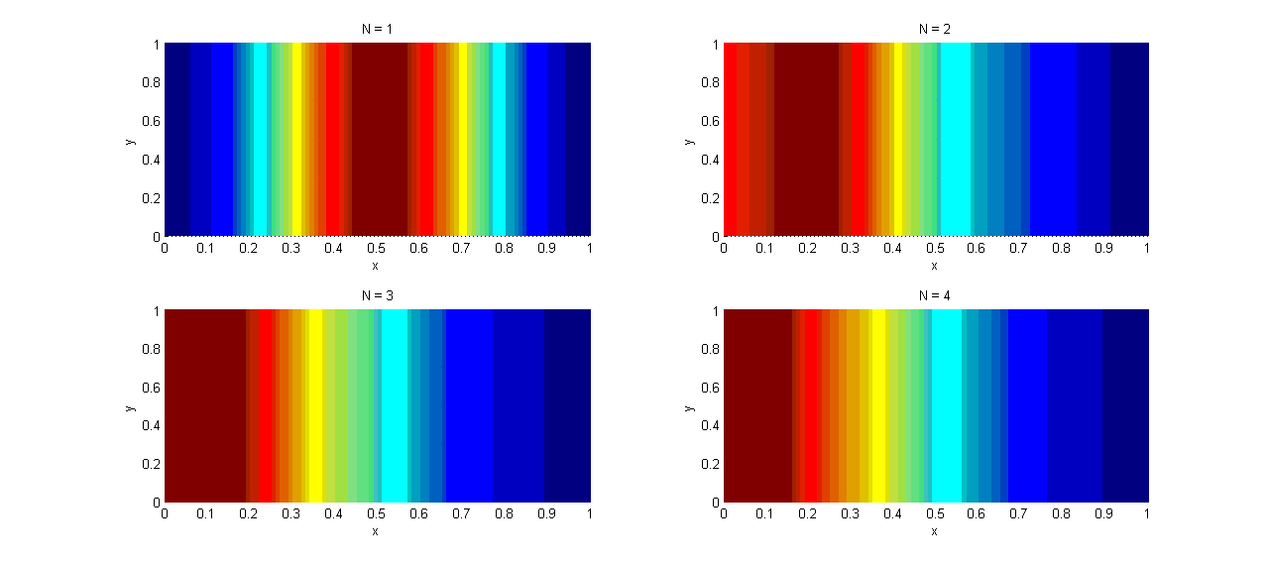
Non-uniformity increases with N
For N>1, once the solutions are on the asymmetric branch, max. temperature is always on one side.
If a solution with max at
then there is another with maximum at
One stripe for all N.
For N>1, one edge of the slab is very hot.
As N increases, the stripe moves to the side and maximum temperature increases (for same value of P). This shows that asymmetric branch becomes more unstable as N increases.
Notes:
Du’’-2L(u)+Ge^{Cu}S=0. Sol u_0 with max at x_0. T.S. another soln u_1 with max at 1-x_0:

Slide 22
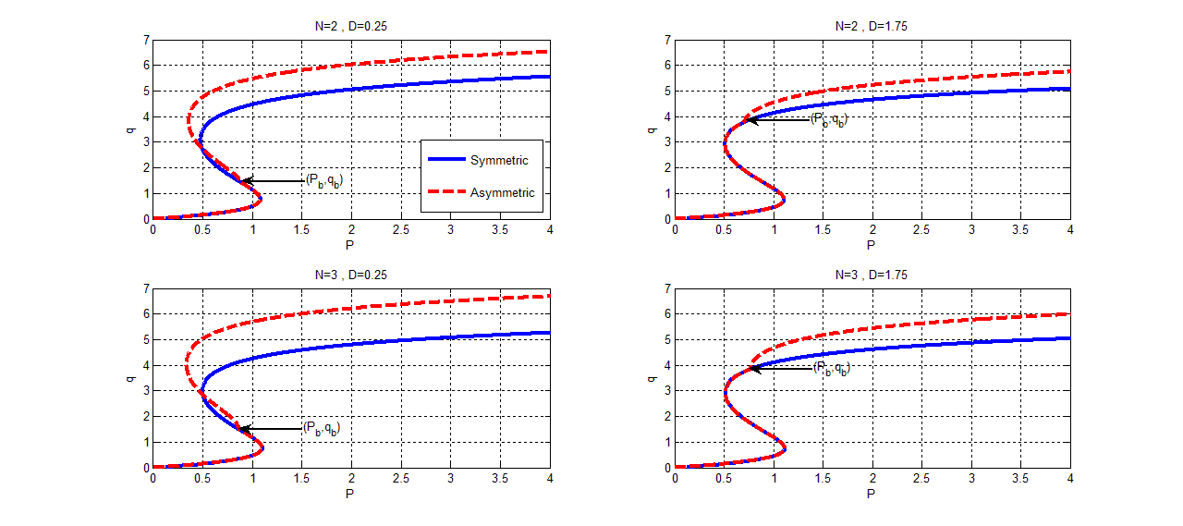

Slide 23
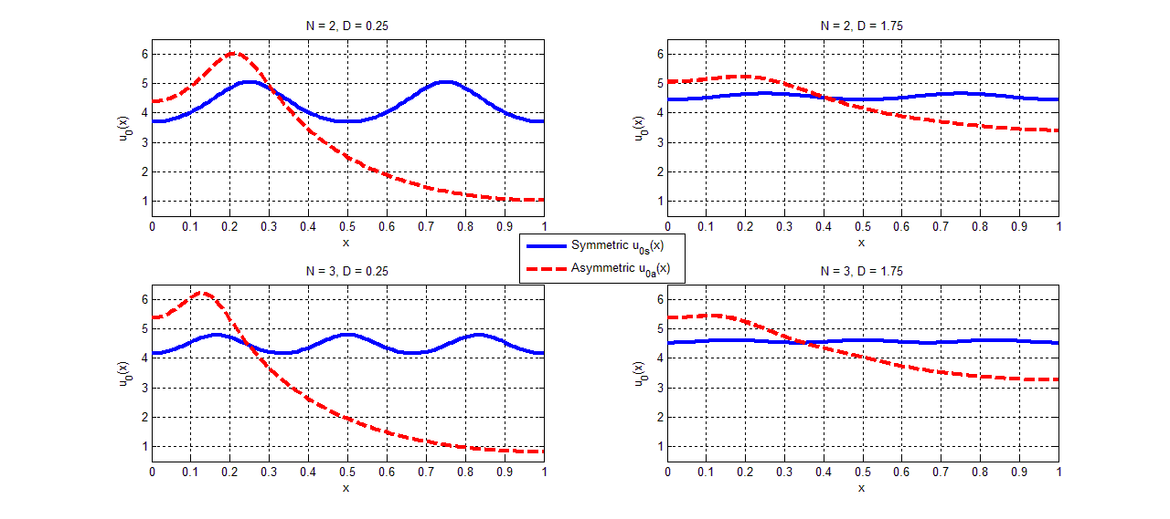

Slide 24
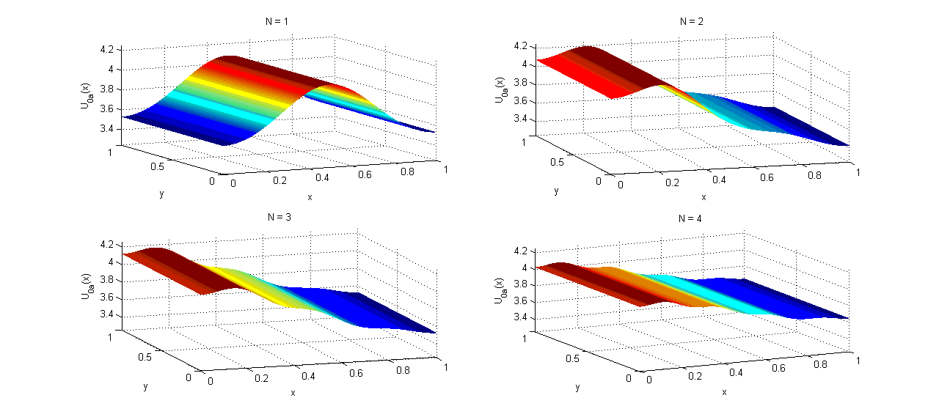
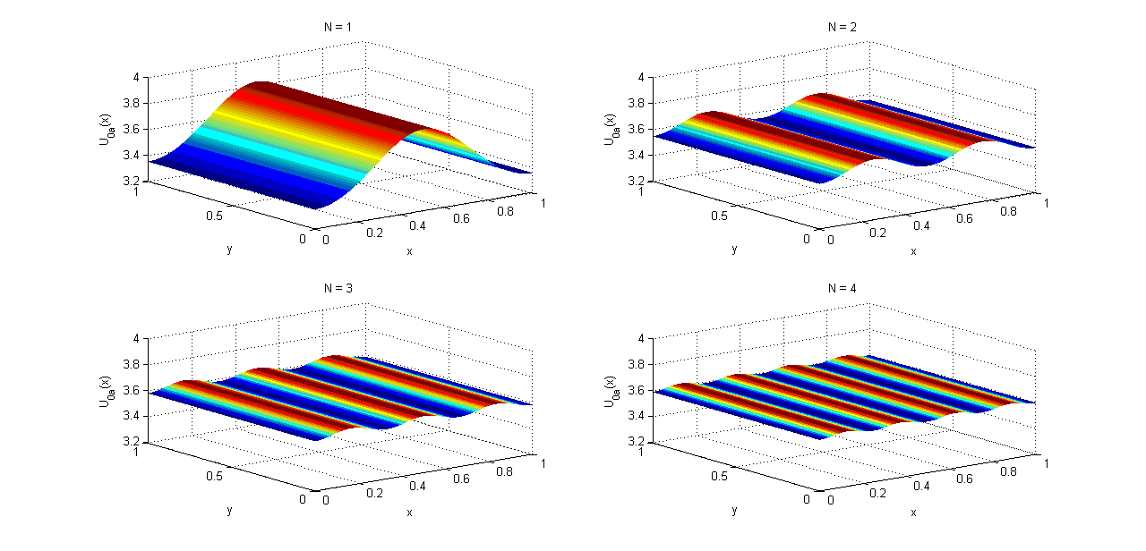

Slide 25
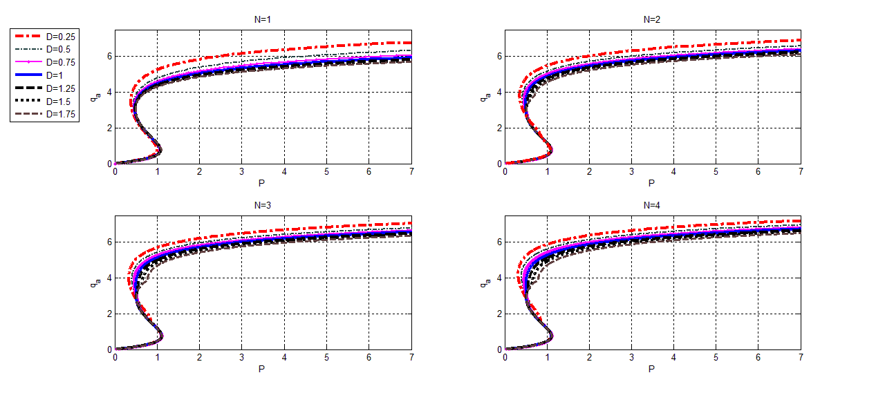
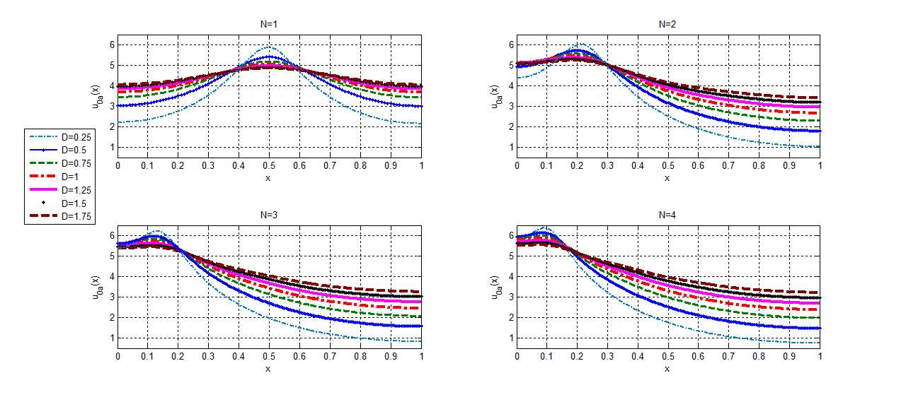
Maximum temperature q_{a} as a function of power for several values of D and N
Asymmetric stationary temperature as a function of x when P=2
For the same value of power, maximum temperature is more for a smaller value of D. This holds for all values of N. (same as symmetric case)
Asymmetry and non-uniformity increase with N
In the symmetric case, for a large N, the solutions were quite uniform even for small values of D. But here for a large N asymmetry increases as D decreases.

Slide 26
Linear stability analysis
(E1)

Slide 27
Stability of stationary solution
Case n=0: Non local eigenvalues
When the symmetric stationary solution is used in (E1) and P<<1, a simple perturbation expansion of (E1) gives
Case n>=1: Local eigenvalues
The shooting method is used again to find the eigenvalues and eigenfunctions. The above values provide the starting values to begin the continuation procedure to determine as a function of .

Slide 28
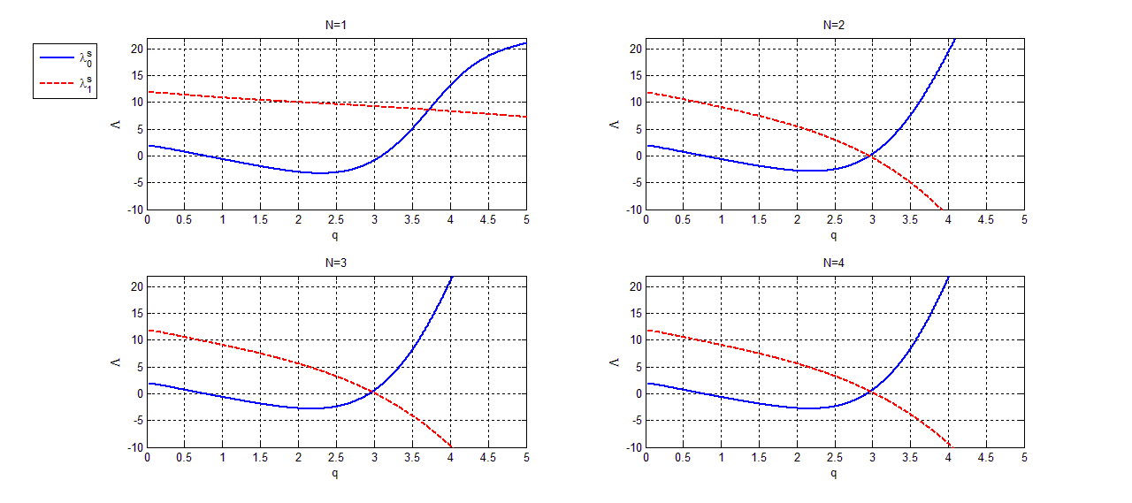
Lowest eigenvalue is unstable on the middle branch. For D=1 and N>1, the second non-local eigenvalue becomes negative just where the lowest eigenvalue was going to become positive.
if j is odd and j<N. e.g. for N=4. This suggests that another asymmetric bifurcation branch emerges where this eiegnvalue becomes negative.

Slide 29
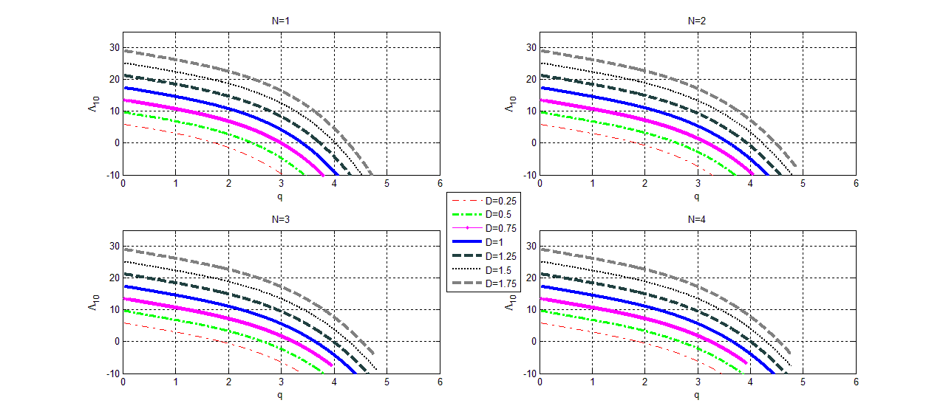
Perturbations in y.
Simple zeros.
Once the eigenvalue is negative, it stays negative.

Slide 30
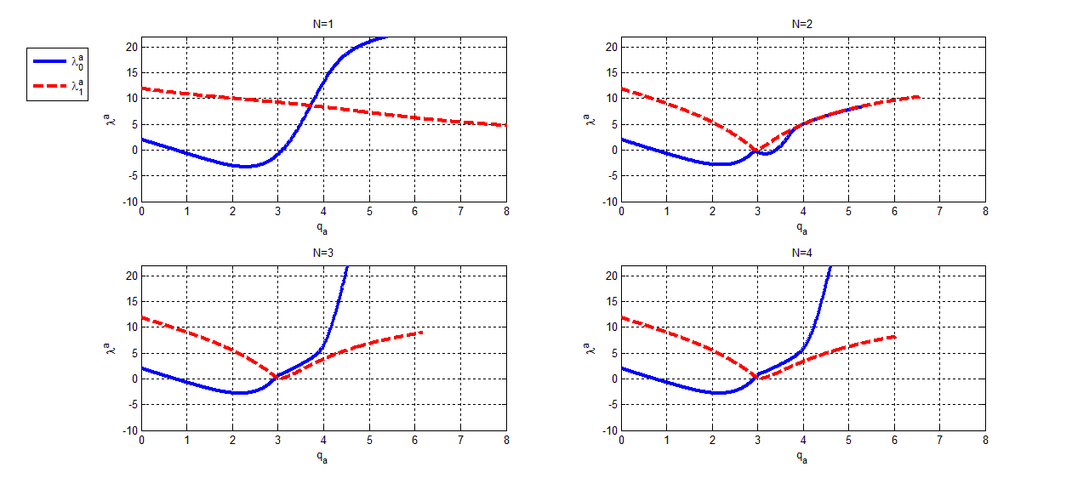
Asymmetric Case
Lowest non-local eigenvalue is unstable on the middle branch in symmetric as well as symmetric cases.

Slide 31
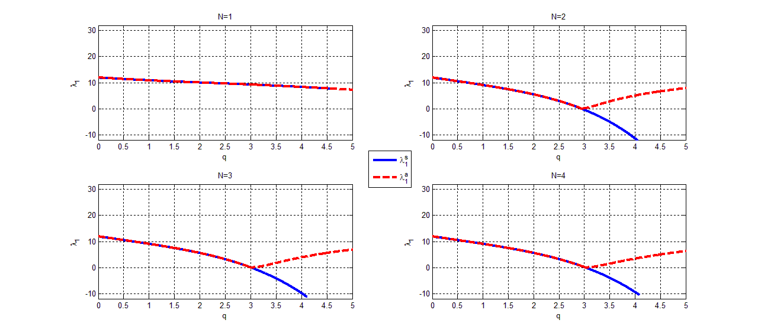
Comparison of second non local eigenvalue for symmetric and asymmetric cases, D=1
Second non-local eigenvalue is stable for the asymmetric case which shows that asymmetric state is more stable than the symmetric state.

Slide 32
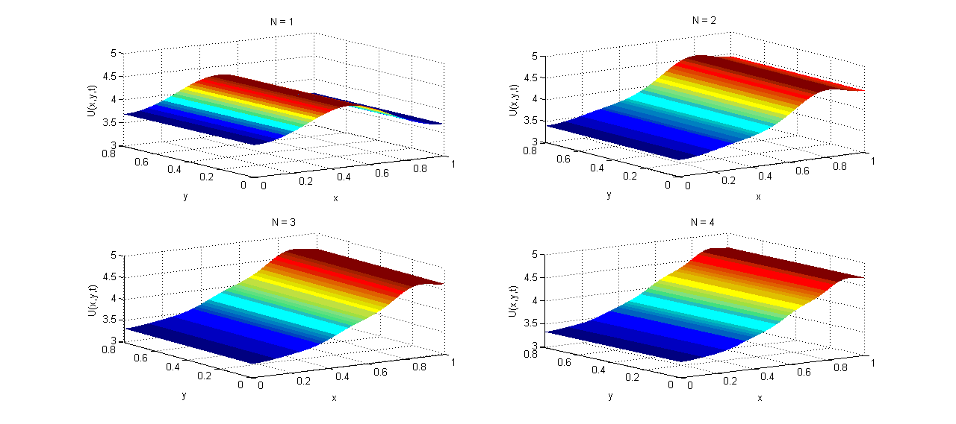
Dynamical simulations (Time Dependent Solutions)
P=1, D=1.75, I.C. Symmetric steady state
At this value of power, only the asymmetric mode in x is unstable and so the symmetric stationary state evolves to the asymmetric stationary state.

Slide 33
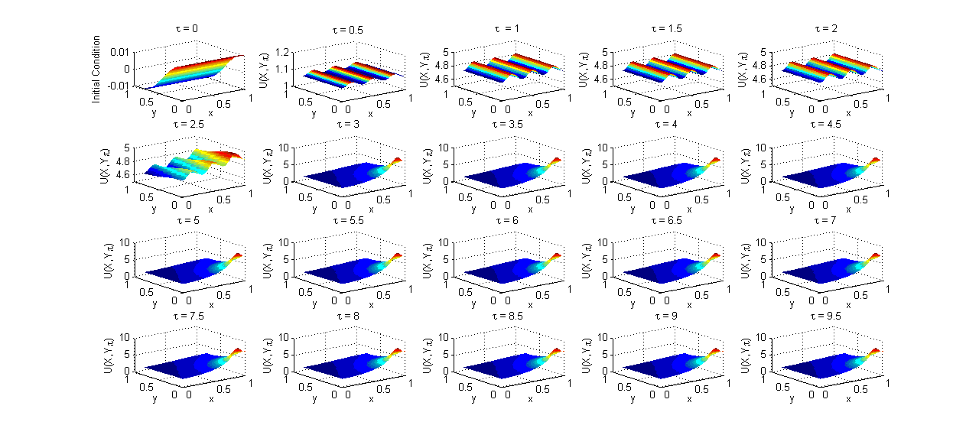
P=3, D=1.75, N=3, I.C. :
When P=3, both are unstable for N=3. The initial data first evolve to symmetric steady state, then asymmetric state and finally to a spike.

Slide 34
Reduced Model (Case N=1)

Slide 35
Steady State Problem

Slide 36
Steady State Solution

Slide 37
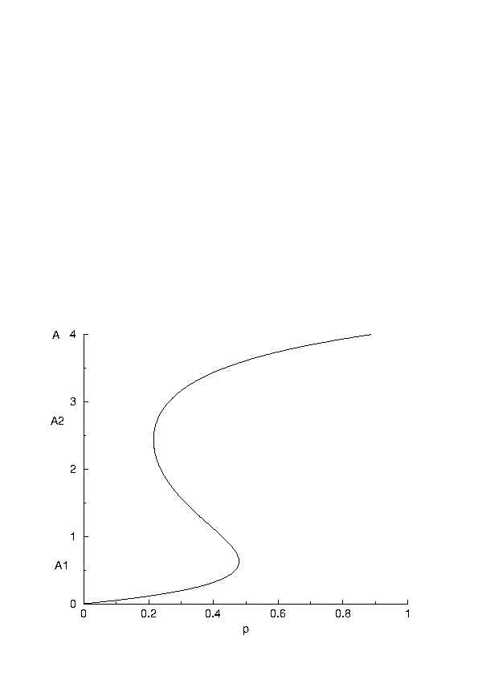
Steady State Plots
Steady State solution branch for Amplitude A versus power p

Slide 38
Reduced Model (Case N=2)
Steady State Problem

Slide 39
Steady State Solution

Slide 40
Symmetric and Asymmetric Steady States

Slide 41
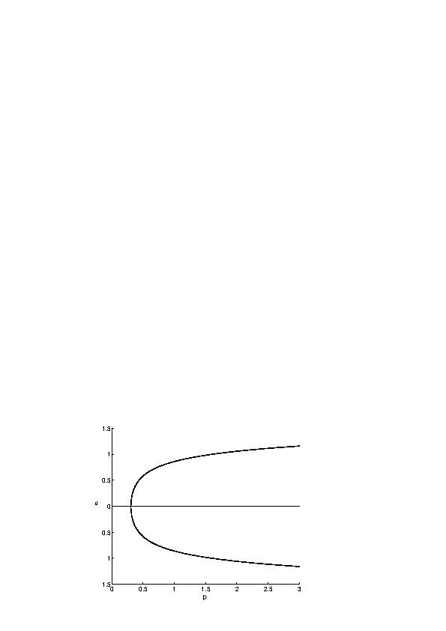
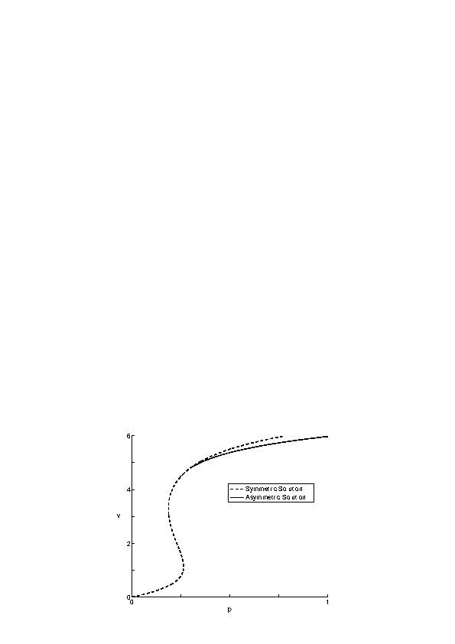
A Pitchfork Bifurcation

Slide 42
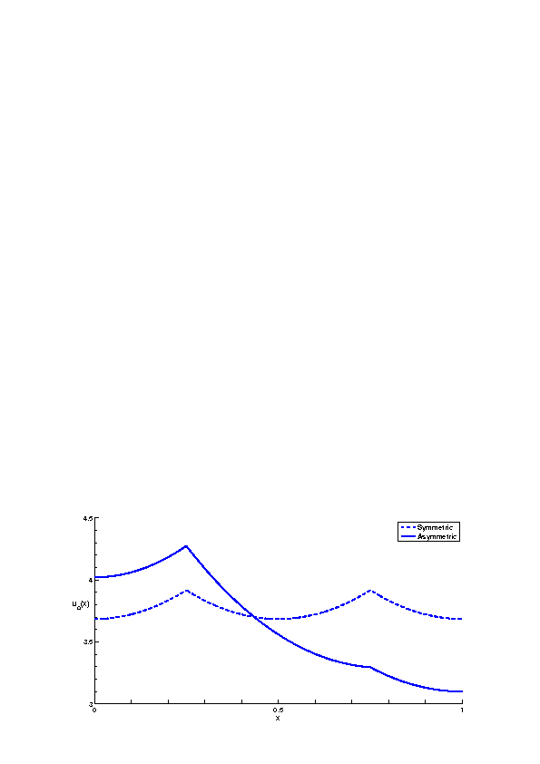
Steady States in terms of u and v
Steady state temperature versus x with at applied power p = 0.7

Slide 43
Conclusions
We found two stationary states, viz, symmetric and asymmetric. This is not a mathematical aberration but a property which is inherent in the structure of the problem. This has been demonstrated by finding completely analytic solutions to our Model Problem where a delta function is used in place of the real electric field source.
For a given D, if a value of power can be chosen so that Pc<P<Pb, then any initial data will evolve to symmetric stationary solution which is stable since there are no unstable modes in this portion of the S-curve.
If D is big enough so that PL<Pb, then values of power P such that PL<P<Pb correspond to stable portion of the curve.
Initial data that average to solutions corresponding to upper branch will also evolve to stable uniform solutions.

Slide 44
References
Agrawal S., and Kriegsmann Gregory A., “A Simple Model for the Microwave Heating of a Thin Ceramic Slab in a Multimode Microwave Cavity”, IMA Journal of Applied Mathematics, Volume 78, Issue 4, Pages 652-664, 2013.
Agrawal S., Uniform Heating of Thin Ceramic Slabs in a Multimode Microwave Cavity, PhD Thesis, NJIT, USA, 2011.
Booty Michael R. and Kriegsmann Gregory A., Microwave Heating and Joining of Ceramic Cylinders: A Mathematical Model, Methods and Applications of Analysis. 1(4): 403-414, 1994.
Brodwin Morris E. and Johnson Lynn D., Microwave Sintering of Ceramics. IEEE MTT-S Int. Microw. Symp. Dig., 1, Pages 287-288, 1988.
Brodwin Morris E. and Chang J.T., A New Microwave Oven For Efficient Uniform Heating Based Upon A Circular Geometry, Microwave Conference/Brazil, 1993, SBMO International, Vol. 2, August 2-5, pp. 723-727, 1993.
Jerby E., Dikhtyar V. and Aktushev O., Microwave Drill for Ceramics, Ceramic Bulletin, (82), 2003.
Jerby E. and Dikhtyar V., Method and Device for Drilling, Cutting, nailing and Joining Solid Non-Conductive Materials using Microwave Radiation. US Patent 6,114,676, 2000.
Kriegsmann Gregory A., Thermal Runaway in Microwave Heated Ceramics. Journal of Applied Physics, (71), Pages 1960-1966, 1992.
Kriegsmann Gregory A., Pattern Formation in Microwave Heated Ceramics: Cylinders and Slabs, IMA Journal of Applied Mathematics, 66, 1-32, 2001.
Walker Stuart J., Multi Mode Cavity Effects on the Microwave Heating of a Ceramic Slab, PhD Thesis, NJIT, USA, 2001.

Slide 45
THANKYOU

